Slide 1

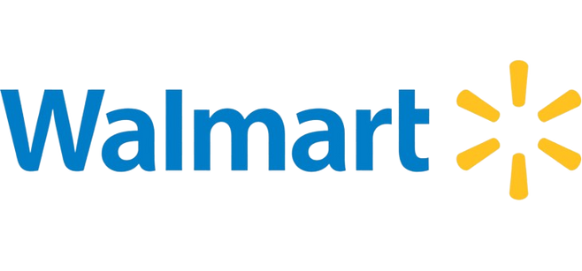

WALMART INC. BUSINESS AND FINANCIAL ANALYSIS
www.walmart.com

Slide 2




TEAM MEMBERS
TIRTH
SHAH
HARSH
DAVE
PRIYAM
MISTRY
HARSHIL
PATEL

Slide 3

CONTENT
01
02
Introduction
Macroeconomic Environment
03
04
Ratio Analysis
CAPM Analysis
05
06
WACC Analysis
Stock Analysis
07
Monte Carlo Simulation
08
FB Prophet Analysis
09
10
Key Insights
Recommendations

Slide 4
INTRODUCTION
Current Operations:
Walmart Inc. is a global retail giant operating across various segments, including retail, wholesale, eCommerce, and other units. Founded in 1945 and headquartered in Bentonville, Arkansas, Walmart has evolved from a single discount store to a diversified retail empire with a presence worldwide.
01
Products:
Offers a wide range of products including groceries, apparel, electronics, home goods, and more.
02
Servies:
Walmart Pay: Mobile payment service.
Walmart+: Subscription service offering benefits like unlimited free delivery, member prices, and more.
Online grocery pickup and delivery: Allows customers to order groceries online and pick them up at stores or have them delivered to their doorstep.

Slide 5



MACROECONOMIC ENVIRONMENT
Growth:
Competitors:
Market Share:
Organic Growth: Expanding physical stores globally and enhancing online presence.
Mergers & Acquisitions: Acquisition of Flipkart to strengthen eCommerce footprint in India.
U.S. Dominance: Walmart holds approximately 20-25% of the market share across various retail segments in the U.S
Global Presence: Walmart has approximately 11,000 stores globally.
Major Competitors: Amazon, Target, Costco.
Regional & Local Retailers: Competing in various markets with specialized offerings.

Slide 6
RATIO ANALYSIS
01
Profitability Ratios:
Gross Margin: 24.38%
Walmart's gross margin of 24.38% indicates that the company retains approximately $0.24 from each dollar of sales after accounting for the cost of goods sold.
Operating Margin: 4.17%
Walmart's operating margin of 4.17% reflects the profitability from core business operations after deducting operating expenses.
Return on Assets (ROA): 6.15%
Walmart's ROA of 6.15% signifies that the company generates a return of 6.15% on its total assets.
Return on Equity (ROE): 18.5%
Walmart's ROE of 18.5% indicates that the company generates a return of 18.5% on shareholders' equity.
STATISTIC

Slide 7
RATIO ANALYSIS
02
Liquidity Ratios:
Current Ratio: 0.83
Walmart's current ratio of 0.83 indicates that the company has $0.83 in short-term assets to cover each dollar of short-term liabilities. A current ratio below 1 suggests potential liquidity issues and may indicate difficulties in meeting short-term obligations.
Quick Ratio: 0.24
Walmart's quick ratio of 0.24 reveals that the company has $0.24 in liquid assets (excluding inventory) to cover each dollar of short-term liabilities. A quick ratio significantly below 1 raises concerns about the company's short-term liquidity and its ability to cover immediate obligations without relying on inventory sales.
Cash Ratio: 0.11
Walmart's cash ratio of 0.11 signifies that the company has $0.11 in cash and cash equivalents to cover each dollar of short-term liabilities. A low cash ratio indicates a limited ability to cover short-term liabilities with readily available cash, which could pose liquidity risks.
STATISTIC

Slide 8
RATIO ANALYSIS
03
Price to Earning Ratio (P/E):
Walmart, the Price-to-Earnings (P/E) ratio is calculated to be approximately 27.28. This means that investors are willing to pay around $27.28 for every dollar of Walmart's earnings. A P/E ratio of this magnitude suggests that the market has relatively high expectations for Walmart's future growth and profitability.
STATISTIC
04
Debt to Equity Ratio:
Walmart's Debt-to-Equity Ratio of 0.73 indicates a balanced approach to financing. For every dollar of equity, Walmart has $0.73 of debt, demonstrating a conservative financial stance. This lower ratio suggests that Walmart manages its capital structure prudently, maintaining a healthy balance between debt and equity while minimizing financial risk.

Slide 9
CAPM ANALYSIS
CAPM
The Capital Asset Pricing Model is a financial model that calculates the expected return on an investment based on its risk.
Beta: 0.5287
A beta value of 0.5287 indicates that the stock is less volatile than the market, reflecting lower systematic risk compared to the market.
Expected Return for WMT: 8.89%
Walmart's expected return of 8.89% is calculated using CAPM, considering the risk-free rate, market return, and Beta value.
This expected return represents the return required by shareholders adjusted for the company's risk profile.

Slide 10

WACC ANALYSIS
WACC:
The Weighted Average Cost of Capital (WACC) is a financial metric that provides the blended cost of a company's equity and debt financing, serving as a discount rate for investment analysis and valuation.
Walmart's WACC of 5.93% indicates a relatively low cost of capital, which may be attractive to investors and beneficial for the company's investment and financing decisions.

Slide 11
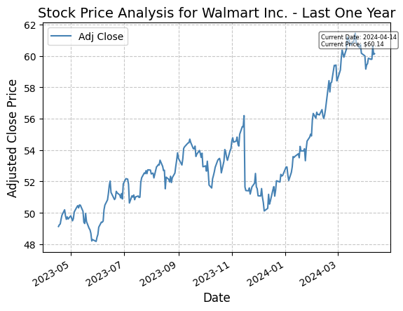
STOCK ANALYSIS
Stock Price Trends: Walmart's stock price has shown a generally upward trend over the past year, starting from $48.34 in May 2023 and reaching $60.14 in April 2024.
There are fluctuations in the stock price over the year, with highs reaching $61.66 in March 2024 and lows dropping to $48.20 in june 2023.
The stock has seen support around the $48-$52 range and resistance around the $60-$61 range over the past year.

Slide 12
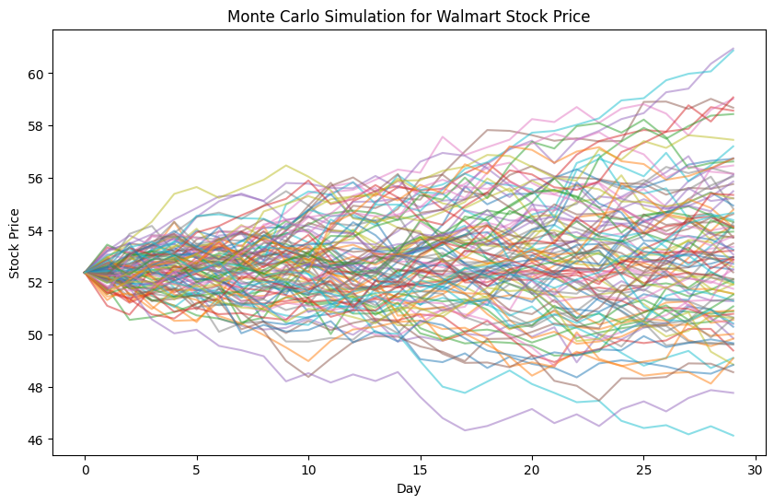
MONTE CARLO SIMULATION
To forecast the future stock price of Walmart Inc. using the Monte Carlo simulation method.
Utilized historical stock data from January 1, 2023, to January 1, 2024, to calculate daily returns.
Generated 100 simulated price paths for the next 30 days based on the calculated mean daily return and standard deviation of daily return.
Observed potential stock price outcomes ranging within the historical price range of $46 to $61, indicating the simulation's alignment with past stock price behavior.

Slide 13
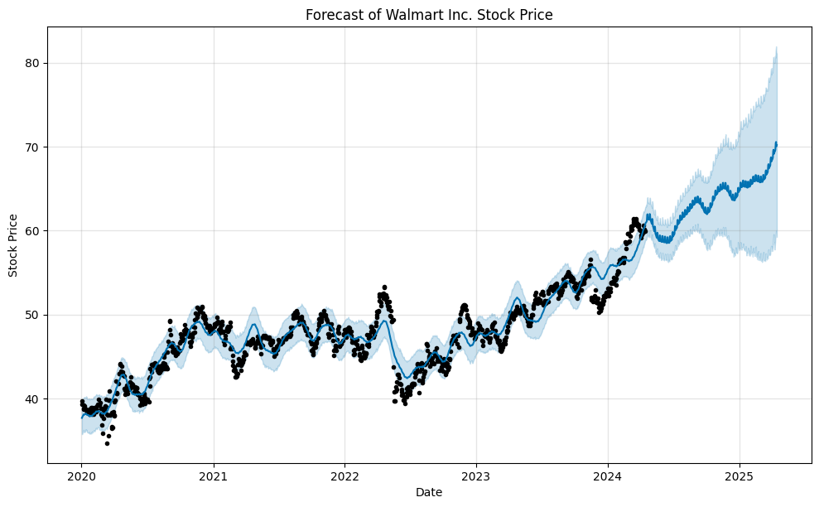
FB PROPHET ANALYSIS
The FB Prophet analysis provides a comprehensive and accurate forecast for Walmart Inc.'s stock price, leveraging advanced time series forecasting techniques to assist investors, analysts, and stakeholders in making informed decisions, managing risks effectively, and planning investment strategies based on the projected stock price trends and insights.
Generated forecasted stock price trends for the next year based on the FB Prophet model's predictions, revealing a consistent upward trend.

Slide 14

KEY INSIGHTS
The FB Prophet analysis reveals a consistent upward trend in Walmart's stock price over the next year, indicating potential growth and positive momentum.
The forecast includes upper and lower bounds, indicating the range of potential stock price outcomes with a specified level of confidence.

Slide 15
RECOMMENDATIONS
Investment Recommendation:
Based on the FB Prophet forecast and analysis, Walmart Inc. appears to be a promising investment opportunity with a projected upward trend and potential for growth in the future.
Buy:
The consistent upward trend and positive momentum forecasted for Walmart's stock price, it may be an opportune time for investors to consider buying shares of Walmart Inc. as part of a diversified investment portfolio.
In a world flooded with marketing noise, Thynk Unlimited stands out as a beacon of creativity and effectiveness.
Sell/Hold:
If already holding Walmart's stock, it might be beneficial to continue holding or consider selling based on individual investment goals, risk tolerance, and market conditions. Monitoring the stock price performance and market dynamics is crucial for making informed decisions.
Reese Miller
Rufus Stewart

Slide 16

THANK YOU
FOR YOUR ATTENTION

